Slide 1

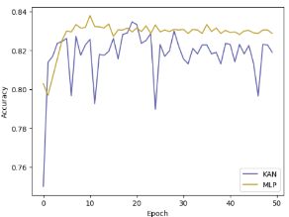
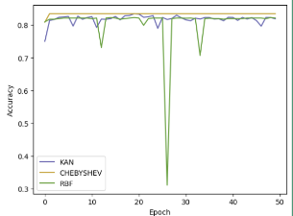
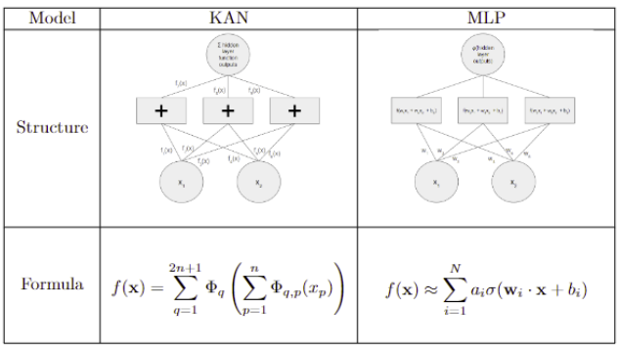
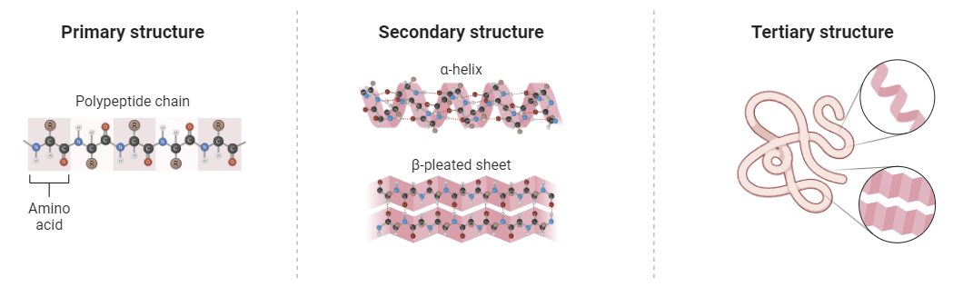
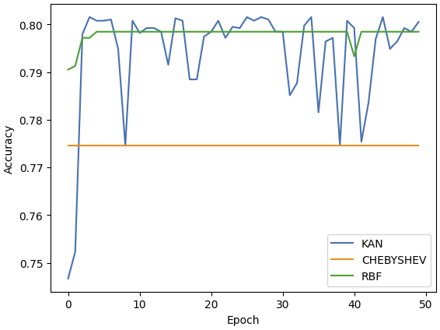
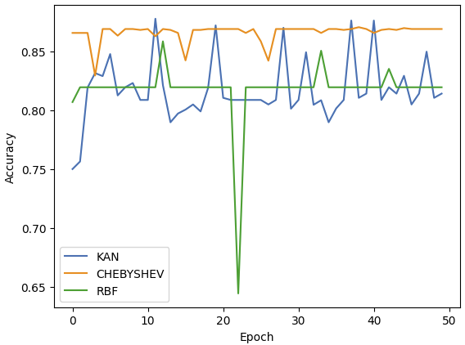
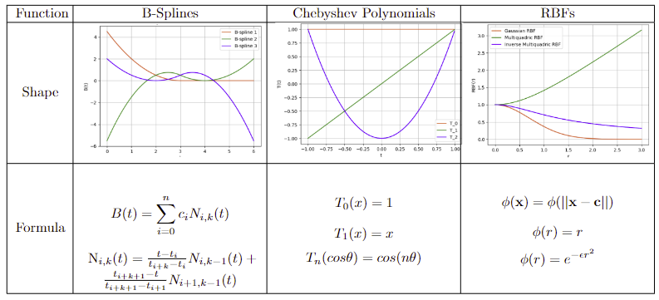
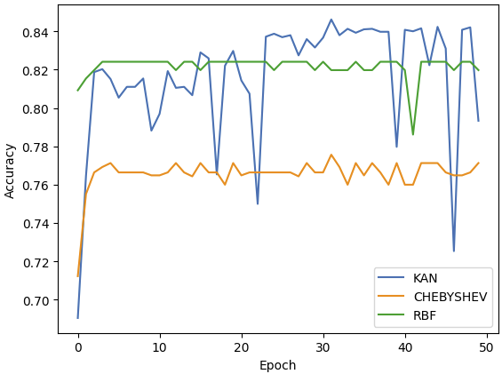
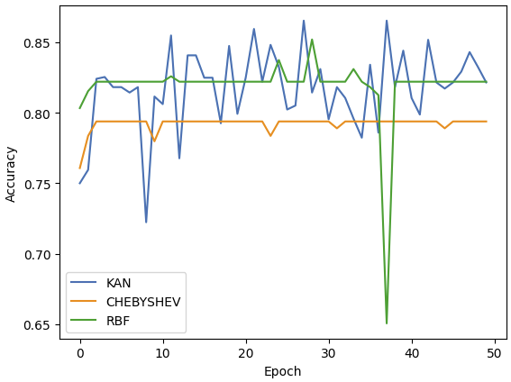
Comparative analysis of KAN with traditional
neural networks like MLP on predicting Protein
Folding Structure
STUDENT RESEARCH INSTITUTE
Kshitij Tyagi, Taniya Sarkar
Watford Grammar School for Boys, Florida State University
[
[
ABSTRACT
MLP vs KAN
KAN COMPARISON
The recently introduced KAN(Kolmogorov-Arnold Network) models have demonstrated significant advantages, including scalability and learnability of the activation functions on edges. In this paper, we explore the potential improvements offered by the KAN architecture over traditional MLPs (Multi-Layer Perceptrons) in predicting the secondary structures of proteins, as well as comparing the performance of KANs with various activation functions. Our findings reveal that the traditional Spline-KANs exhibit slightly faster convergence with similar accuracy while some refinements (RBF-KANs and Chebyshev-KANs) show much faster convergences with great stability. Furthermore, we assessed the robustness of KAN with different activation functions, concluding that all KAN variants are robust with varying levels or robustness at varying levels of contamination.
Table 1. Comparison of MLP vs KAN model structure
Figure 2. Accuracies of KAN and MLP on the dataset over 50 epochs
Figure 3. Comparison of KAN model performances with different activation functions on the dataset over 50 epochs
Figure 1. Primary to tertiary representation of Protein structures
ROBUSTNESS TESTING
FUNCTIONS
ACKNOWLEDGEMENTS
I thank Taniya Sarkar, my mentor, for her help with the research paper, the poster and the code as well as Harvard OpenBio SRI Staff for this opportunity.
Table 2. Comparison of used function sets

